Slide 1


Slide 2
Question: Does participation in Hired Heroes’ volunteer program raise the probability that a client gets hired?

Slide 3
Presentation Overview
Data Exploration
Challenges of data
Summary Statistics
Methodology: Rubin’s causal model for potential outcomes
Propensity score matching
Data cleaning, wrangling, and feature engineering/selection
Model specification and validation
Results, conclusions, recommendations

Slide 4
Data Exploration: Summary Statistics

Slide 5
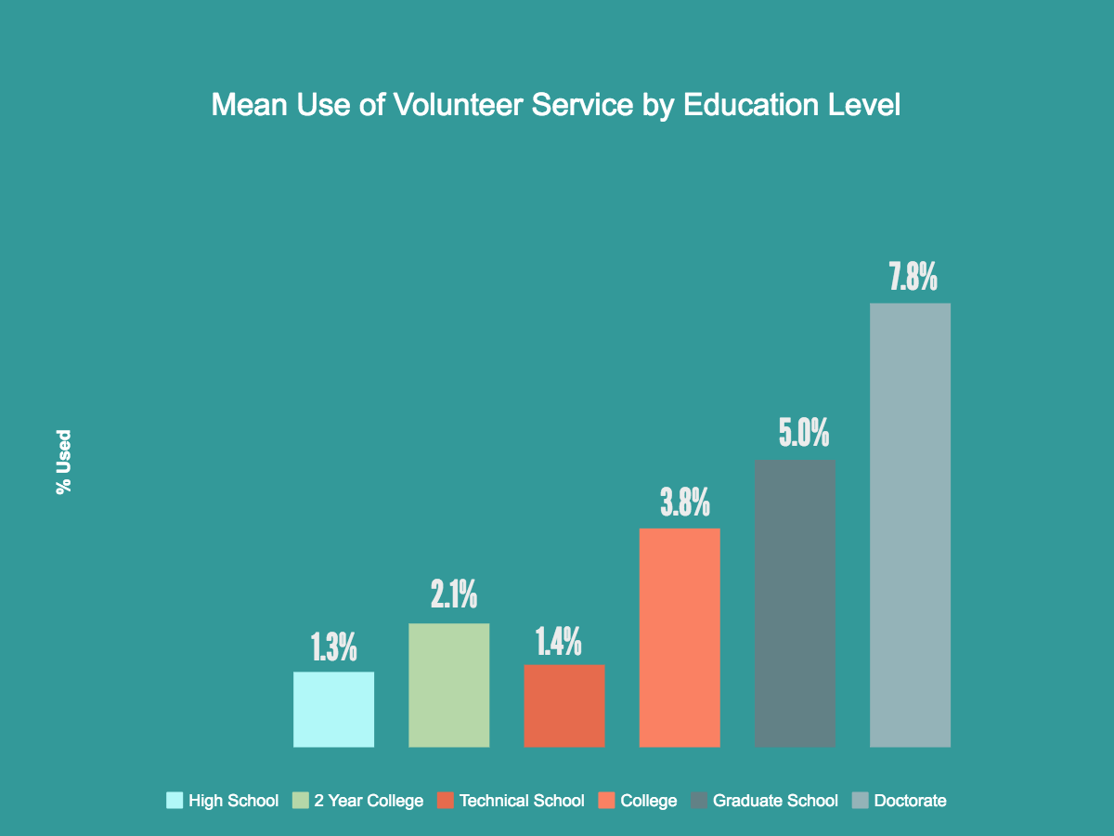

Slide 6
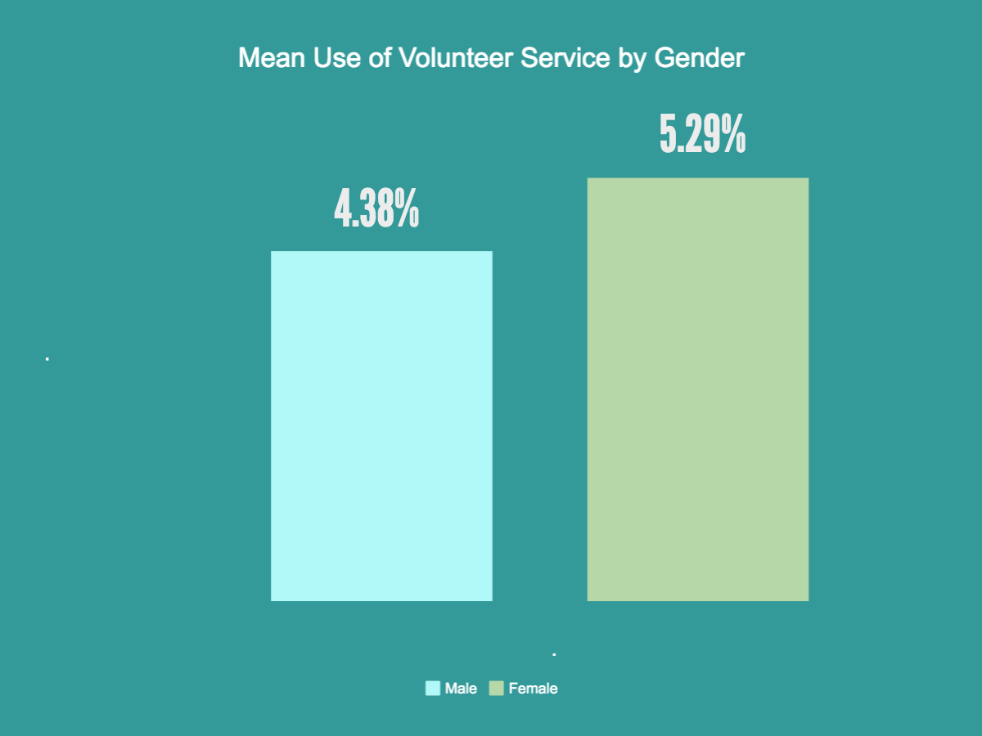

Slide 7
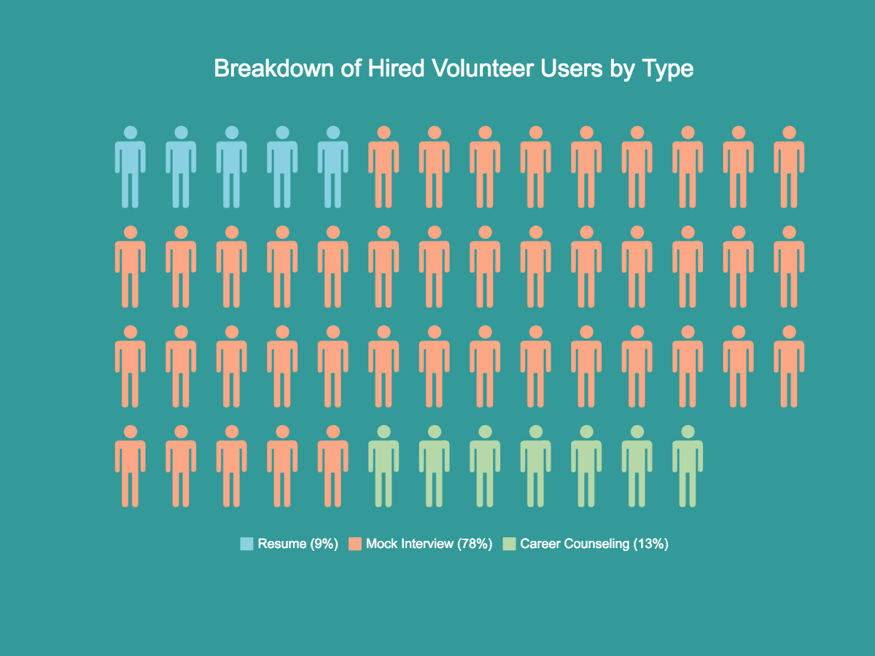

Slide 8
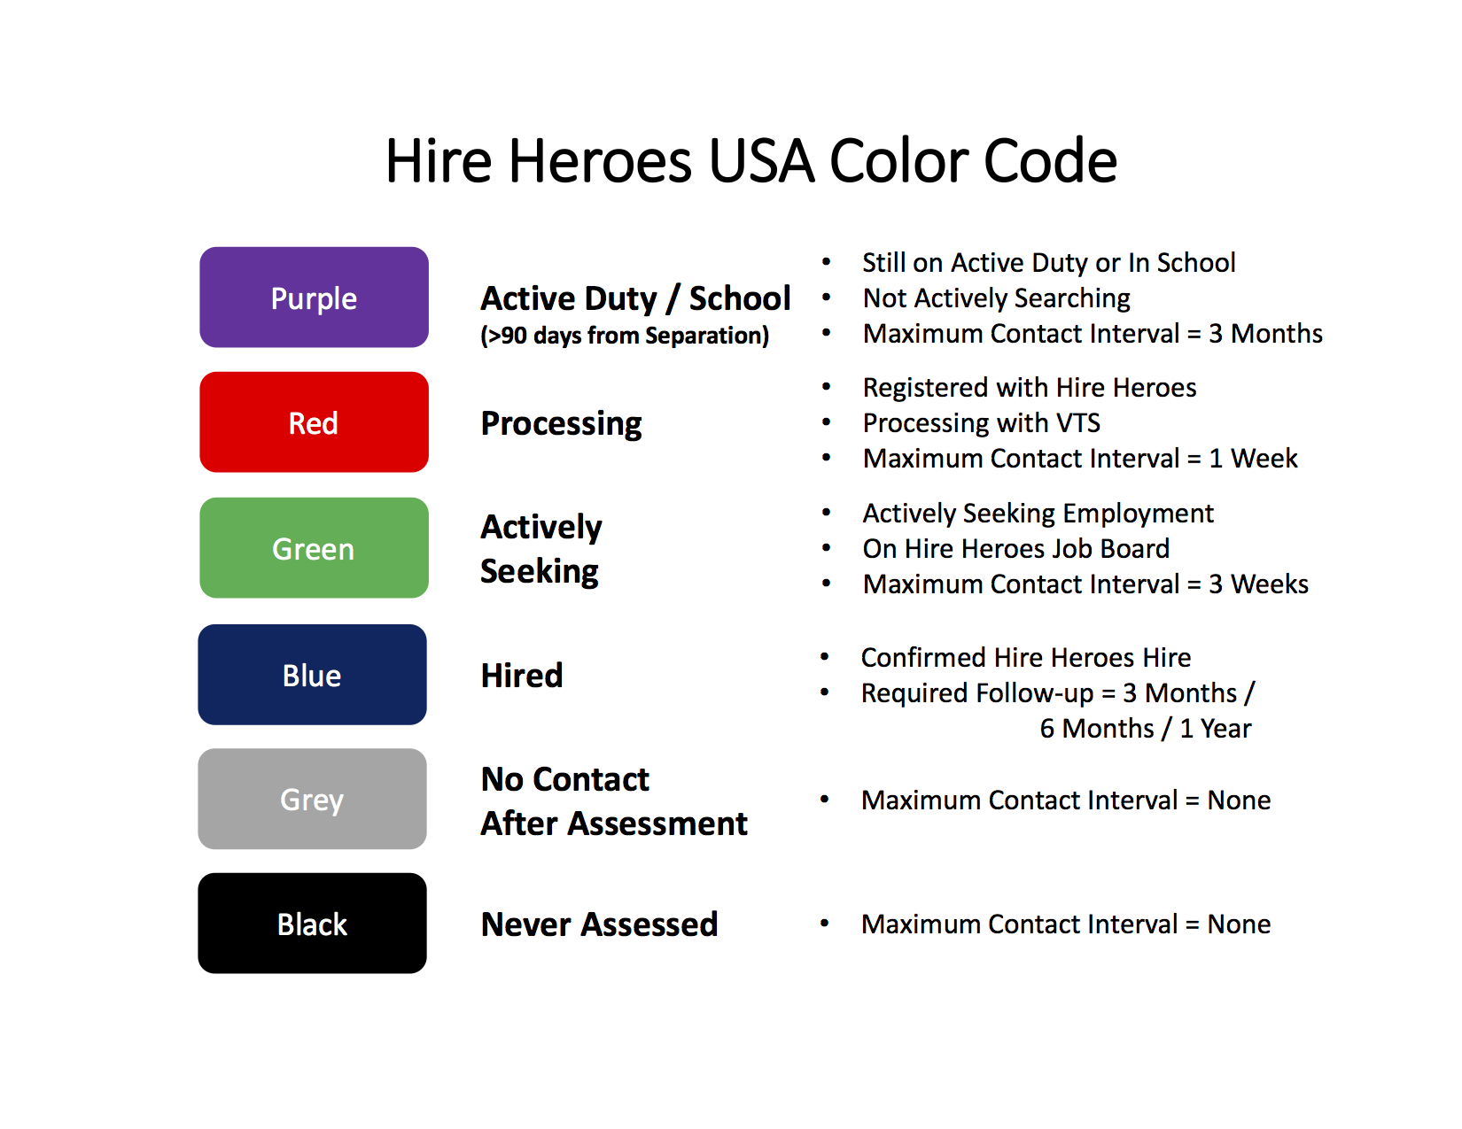

Slide 9
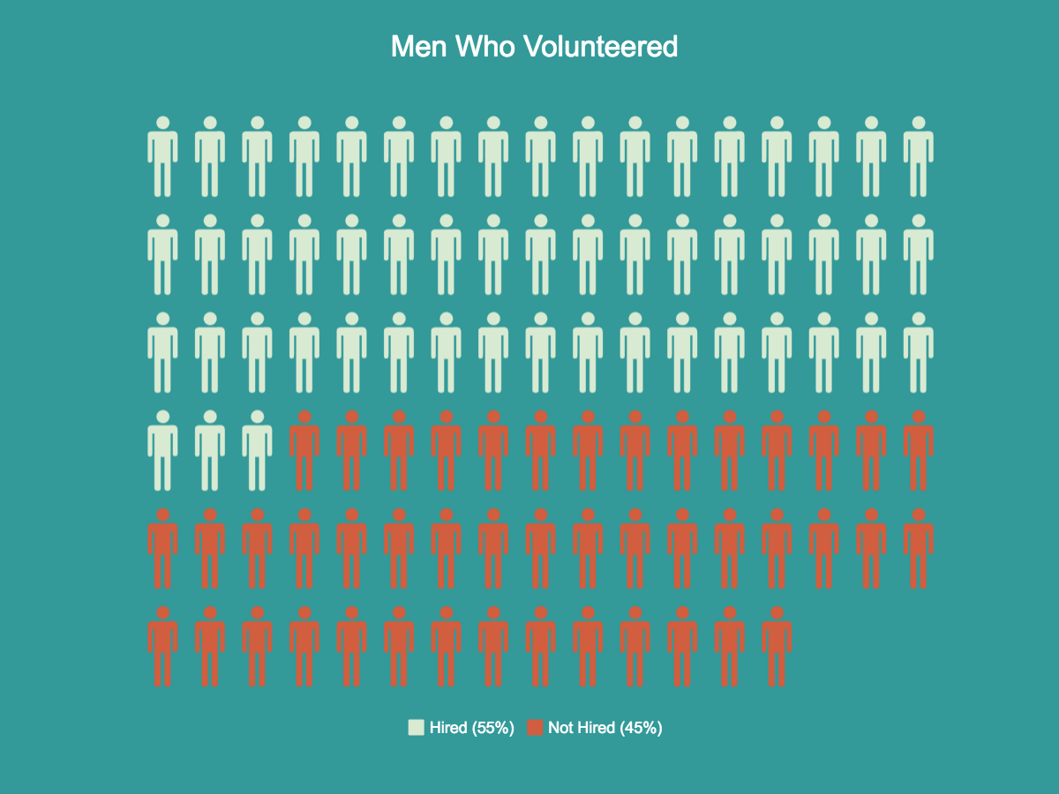
Men Who Used Volunteer Services

Slide 10
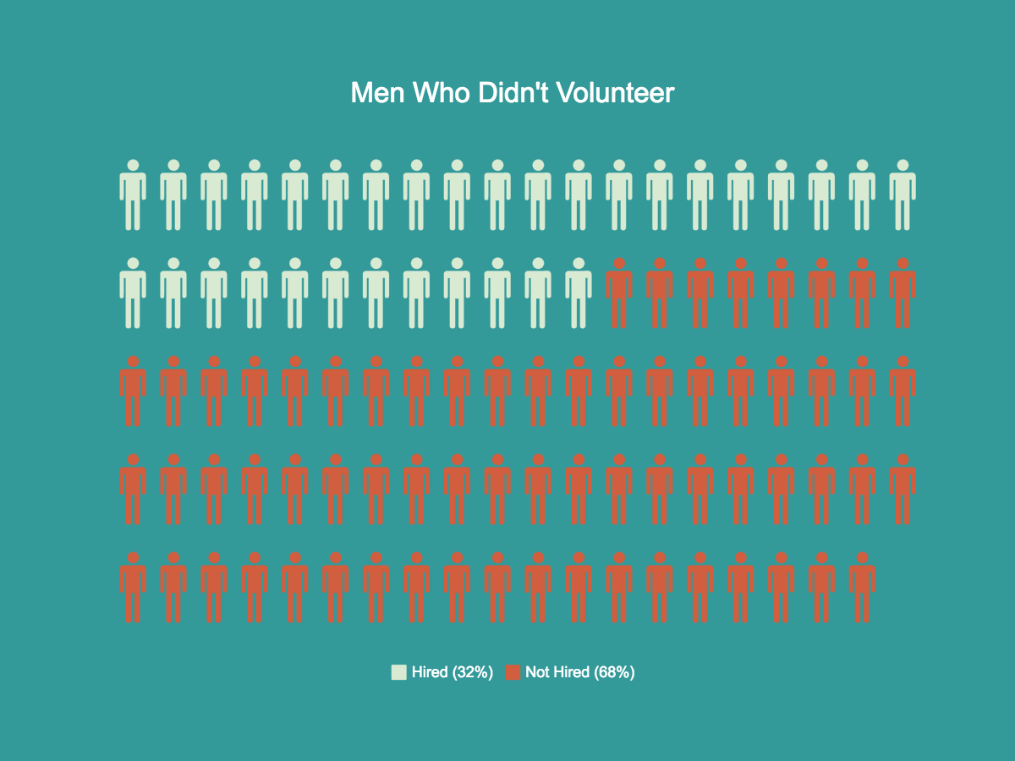
Men Who Did Not Use Volunteer Services

Slide 11
Data Exploration : Challenges

Slide 13
Methodology: Rubin’s Causal Model

Slide 14
Fundamental Problem of Casual Inference
If the treatment, volunteer services, were exogenous we could estimate its effect on employment directly. However, not likely to be the case.
Following Rubin (1974), let the treatment T_{i} ∈ {0,1} indicate whether person i received the treatment, i.e., volunteer services. I define the individual treatment effect as:
ITE = Y_{i}(1) – Y_{i}(0)
Fundamental Problem of Causal Inference (Holland 1986): we never observe both potential outcomes for the same individual at the same point in time.
Let the average treatment ATE = E[Y_{i}(1) –Y_{i}(0) | X_{i} = x]

Slide 15
Key Assumptions in Casual Inference
Huge assumption: once we control for a set of X covariates, there are no variables that affect both T and Y.
Untestable assumption, but more plausible if X is a “rich” set of covariates.
T
Y
X
U

Slide 16
Propensity Score Matching
Let p(X_{i}) be the propensity of treatment. Rosenbaum and Rubin (1983) demonstrate that the conditional independence of the treatment can be re-written as: Y_{i} ⊥( T_{i} |p(X_{i}) )
Two Stage
First estimate propensity of treatment given X.
Then, we can get an estimate of the treatment effects by regressing Y on the Treatment weighted by propensity.

Slide 17
Data Wrangling and Feature Engineering

Slide 18
Data Wrangling and Feature Engineering
Removed covariates with almost zero variance.
Reduced dimensionality from 653 covariates to 96.
Total of around 65,00 observations.
Removed highly-correlated features.
Transformation and Aggregation
Salary, Education, Military Rank
Time Variables
Separated into month and year.
Zip Codes
Replaced zip codes with MSA factors (government data)
“Areas of Expertise”
How to classify text data?

Slide 20
K-Means Clustering (“Areas of Expertise”)
Ideally want to recover some of the signal from the text data.
K-means is an unsupervised learning technique, i.e., no predetermined categories.
I first cleaned the text data to get rid of punctuation, numbers, common words to get the most relevant words.
K-means then assigns a number of centroids and then iteratively reassigns each centroid each time around to get drag them closer to the mean of the clusters.

Slide 22
Independent Variable Selection

Slide 23
Variable Selection Goals
Significant marginal contribution to predictive power.
Low correlation among other variables.
Prefer model simplicity, but also want to have enough types of covariates to preserve “richness” argument.

Slide 24
Final Model Specification Criteria
Econometric Sense
Keep variables that are important for many econometric models, e.g., wage, education, military rank.
Minimize redundancy
Removed/Combined features that had the same information
Irrelevant Variables
“Banquet Guests,” or “Saturday softball.”
ID Variables are not informative.
Rough Model Run
Removed variables that did not have much, or any, marginal contribution.
End up with 56 covariates.

Slide 25
Model Output

Slide 26
Volunteer Program Evaluation Procedure
Estimate propensity of receiving the treatment, participating in the volunteer program, conditional upon the other covariates.
Use XGBoost algorithm
Transform propensity scores into weights to be used in a linear regression.
For treatment group, 1/e(x) ; for control group, 1/(1-e(x))
Run a regression with hired as the dependent variable and volunteer as the independent variable, weighted by the transformed score.
Rather than conditioning for all the covariates, we only need to condition on the propensity score, which is a scalar variable
Find marginal effect.

Slide 28
Propensity Score Estimation with XGBoost
Traditional econometric procedure uses logit regression
Not effective here due to missing data problem: many model specifications will drop most, if not all, observations.
Imputation procedures (mean, median, knn) did not work well.
To predict propensity scores, I use the XGBoost , an boosted trees algorithm written for R by Tianqi Chen.
Lately has been extremely popular in Kaggle data science competitions. Vast majority of winners incorporate XGBoost in ensembles, many of which solely with XGBoost.

Slide 29
Advantages of XGBoost
XGBoost internally handles the sparse data by initially splitting in the default direction “yes,” while gradually learning which direction to split based on information gain.
XGBoost is a boosting algorithm that sequentially combines a set of weak learners into a strong learner.
Objective function:
Fast computatTraining loss function: minimize log-loss.
Careful Regularization to help avoid overfitting
ion time.
Great performance in data science competitions.

Slide 30
XGBoost (Continued)
Randomly split data set into a train (70%) and a test set (30%).
Cross-validation to find optimal iterations.

Slide 32
Weighted Logitistic Estimation
Now that we have predicted probabilities for each observation, we can balance the treated and untreated classes weighing each observation by its inverse propensity weighting:

Slide 33
Marginal Effects of Weighted Logistic
The interpretation of the coefficients from a logistic regression is not immediately straightforward, so we can show the marginal effect:
Participation in the volunteer program has a causal effect of raising one’s chances of getting hired by 20%.

Slide 34
Recommendations
Recommendations for Hire Heroes
Based on the analysis, the volunteer program has a significant causal effect on hiring outcomes.
Because the volunteer program has been shown to be effective, Hired Heroes should allocate resources in expanding it.
Value added from investments in better data tracking for future data analytic projects.

